Slide 1

G2M insight for Cab Investment
Virtual Internship
By: Camilo Arrieta
25-Feb-2021

Slide 2

Agenda
Executive Summary
Problem Statement
Approach
Hypotheses
Analyses
EDA
EDA Summary
Recommendations

Slide 3
Executive Summary
XYZ is a private firm in US.
Due to remarkable growth in the Cab Industry in last few years and multiple key players in the market, it is planning for an investment in Cab industry.
Following their Go-to-Market(G2M) strategy they want to understand the market before taking final decision.

Slide 4
Problem Statement
Using the multiple datasets provided by the client as well as other useful sources, the objective is to provide meaningful insights to help XYZ firm in selecting the best Cab company for their investment.

Slide 5
Approach
Understand the purpose and content of each dataset.
Join all datasets to perform EDA and modeling/hypothesis testing.
Clean final dataset (remove NA’s, duplicates, transform variables if necessary)
Perform EDA analyses and test the provided hypotheses.

Slide 6
Hypotheses
One company has provided Cab services to more Customers than the other.
One company has a higher profit than the other.
The margin increases proportionally to the increase in the number of customers.
Different segments of Customers have different attributes.
We can predict Profit from KM Travelled by each company.

Slide 7
Analyses
Exploratory Data Analysis (data understanding)
Forecasting profit and number of rides for each Company
Finding the most profitable Cab company
Recommendations for investment

Slide 8
EDA (Exploring data)
To have in mind:
  The data corresponds to the period 31-Jan-2016 to 29-Jan-2019.
  There were no missing values nor duplicates in the final data set.

Slide 9
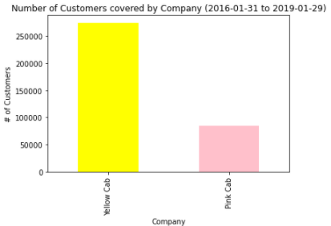
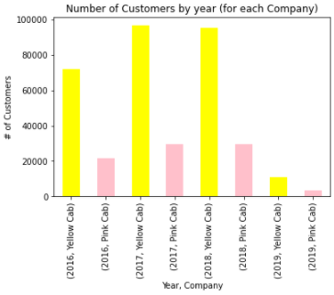
EDA (Exploring data)
As can be seen, the Yellow Cab Company has covered more customers on all years. This, along with a statistically significant Binomial Test, confirms that Yellow Cab covered more customers (Hypothesis 1).

Slide 10
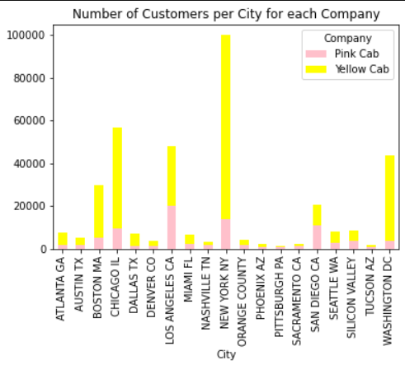
Yellow Cab Company also covered more customers on almost all cities.

Slide 11
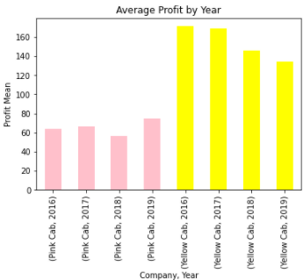
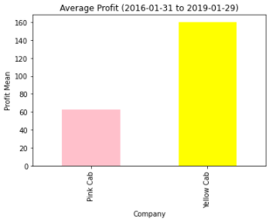
Profit Analysis
Yellow Cab showed a higher profit on all years, with a statistically significant difference from the mean of Pink Cab

Slide 12
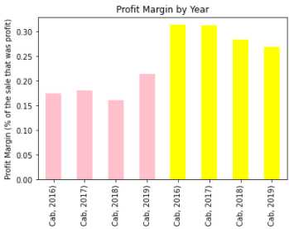
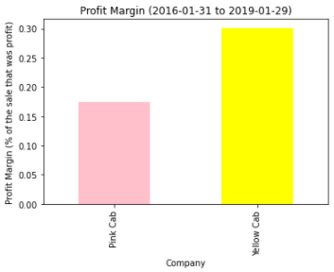
Profit Margin

Slide 13
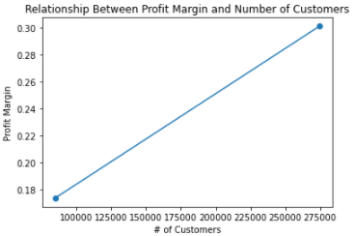
As can be seen, the margin increases proportionally to the increase in the number of customers (Hypothesis 3)

Slide 14
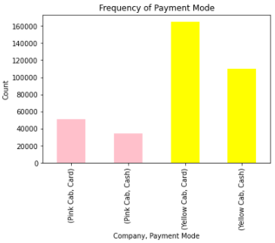
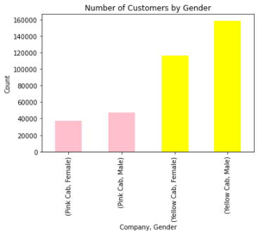
Customer Attributes (Hypothesis 4)

Slide 15
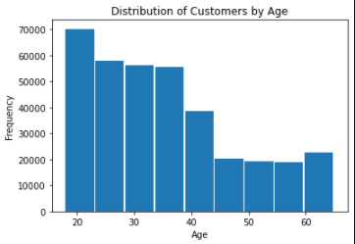
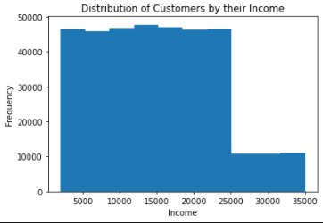

Slide 16
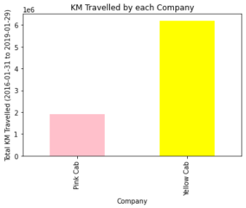
Exploring KM Travelled and Profit

Slide 17
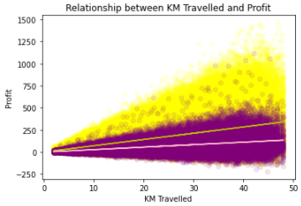
In this case, the slope for the Yellow Cab Company predicts a higher profit for each increase in KM Travelled than the slope for the Pink Cab Company.

Slide 18
EDA Summary
The Yellow Cab Company covered more customers on all years, and on almost all cities.
Yellow Cab showed a higher profit on all years.
Yellow Cab showed a higher profit margin on all years.
The profit margin increases proportionally to the increase in the number of customers.
For both Companies, most Customers were Male, and used Card as their payment type.
Most Customers were between 20 and 40 years, with Incomes varying primarily from 2000 to 25000 USD.
The Yellow Cab travelled more KM, and their predicted Profit from each KM Travelled is higher than the Pink Cab´s.

Slide 19
Recommendations
From the previous EDA, we can accurately say that Yellow Cab has attended more users, has a higher profit and profit margin, has a higher predicted profit for each KM Travelled, and thus should be the best choice for investment.

Slide 20
Thank You

